Slide 1
Senior Project Mobile Game
Caleb Compton
Advised By Nathan Bean

Slide 2
Project Goal
Develop a puzzle-based rpg to run on Android devices
Allow players to customize their gaming experience through modifiable characters and skill choices
Have several different game modes, including Campaign, Free-play mode, and Competitive mode

Slide 3
Gameplay
Connect 3 gameplay – users must choose to use runes for attacks, or match them together to clear them.
Using attacks drains resources, while clearing runes recovers them
Players unlock new runes and abilities from an ever expanding skill tree
Unique boss battles add variety to the gameplay

Slide 4
Requirements
Game should be accessible to as many users as possible
Be simple to understand, yet have significant depth of strategy
Avoid predatory game design practices found in many mobile games

Slide 5
Accessibility Features
Color will be a big portion of the gameplay, and adjustable settings will make the game accessible to the colorblind
Choice of control scheme helps those with less motor control
Options to adjust font sizes for the visually impaired

Slide 6
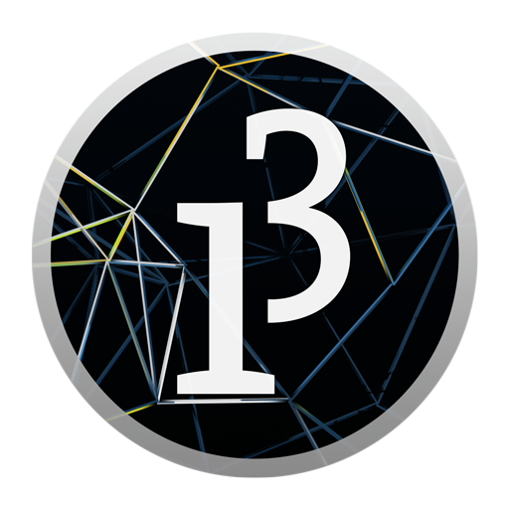

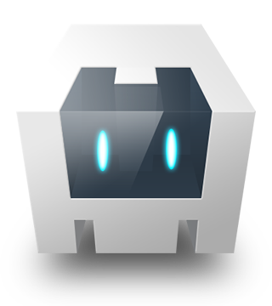
Tools
The primary tool used to develop this game will be Processing for Android
Designed for visual media, which eases the development of games
Game is too simple to justify a full-blown game engine – will be coded from scratch
Processing has access to phone specific features such as accelerometers
Gets compiled into Java object code, which runs natively on Android devices
Has potential for cross-platform support through Processing.js and Apache Cordova

Slide 7
Demo

Slide 8
Timeline
February 28th – Have Demo Functionally Complete
March 15th – Implement Animation Class
April 1st – Implement Characters and Skills
April 15th – Implement map + at least 1 boss
April 30th – Improve Visuals + User Interface
Stretch Goals – Add Story Features, Implement Additional Game Modes, More levels and Bosses

Slide 9
Any Questions?

